Slide 1
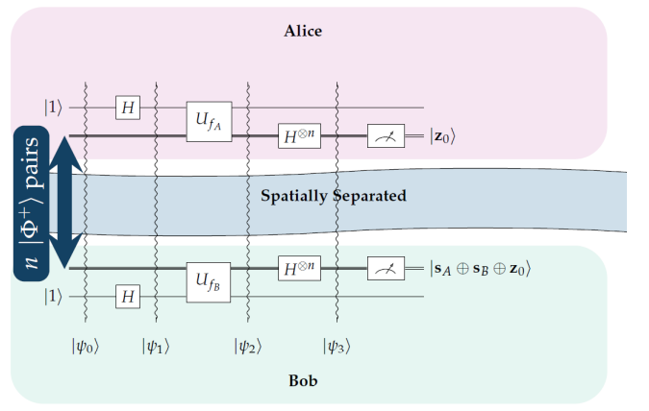
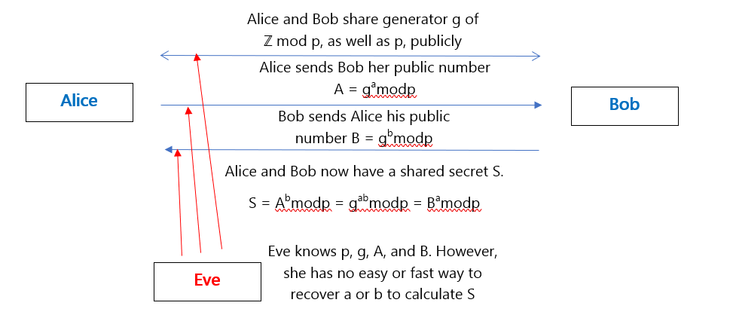
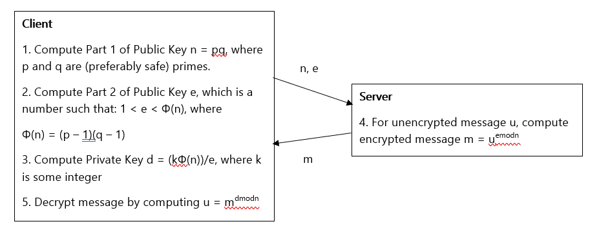
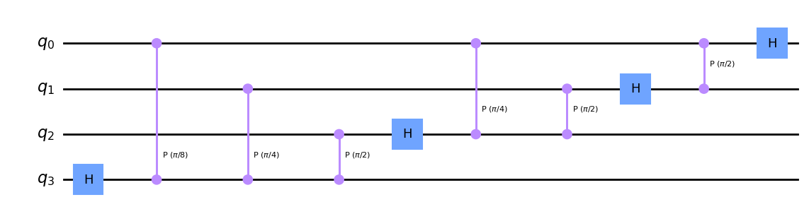


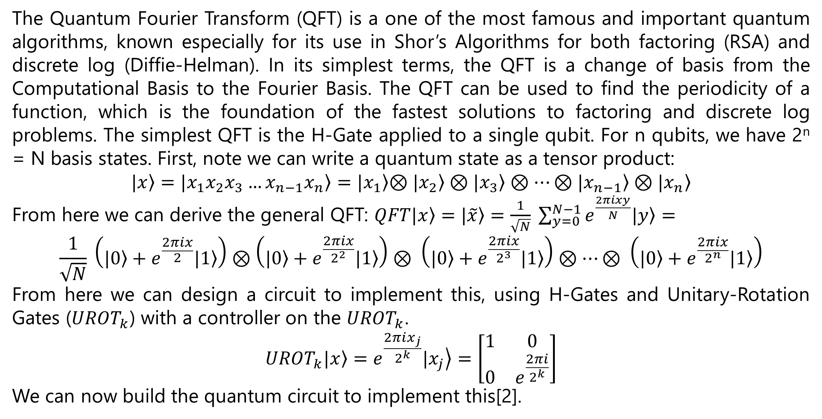
Quantum Cryptography
QKD Using Symmetric Bernstein-Vazirani
Abstract
As quantum computing represents the future of computing technologies, it is important to consider the future of computer security in the Quantum Age. The aim of this research is to provide its viewer a look into what quantum computers are, how they defeat modern cryptosystems, and what the future of cryptography may look like in the quantum age. This research will demonstrate quantum cryptosystems that use quantum technology to provide security, as opposed to classical cryptosystems that are considered “quantum resistant.” Finally, we will discuss how quantum cryptosystems may be attacked.
John Sipahioglu
Quantum Fourier Transform
To understand the Bernstein-Vazirani Algorithm, first consider this game. Alice sends Bob a binary number x, and Bob applies a function f_{s}(x) that maps to {0,1}, based on Bob’s secret number s, and sends the result to Alice. By sending numbers 100…0, 010…0, …, 000…1, Alice can recover s in n steps, which is the best case. The Quantum Bernstein-Vazirani algorithm can solve this in one step. Now we will display an algorithm that uses this idea for a QKD.
The Quantum Fourier Transform (QFT) is a one of the most famous and important quantum algorithms, known especially for its use in Shor’s Algorithms for both factoring (RSA) and discrete log (Diffie-Helman). In its simplest terms, the QFT is a change of basis from the Computational Basis to the Fourier Basis. The QFT can be used to find the periodicity of a function, which is the foundation of the fastest solutions to factoring and discrete log problems. The simplest QFT is the H-Gate applied to a single qubit. For n qubits, we have 2^{n} = N basis states. First, note we can write a quantum state as a tensor product:
$$\left.|x\right\rangle =\left.|x_{1}x_{2}x_{3}…x_{n−1}x_{n}\right\rangle =\left.|x_{1}\right\rangle \left.⊗|x_{2}\right\rangle ⊗\left.|x_{3}\right\rangle ⊗…⊗\left.|x_{n−1}\right\rangle ⊗\left.|x_{n}\right\rangle$$
From here we can derive the general QFT: $\left.QFT\left.|x\right\rangle =|\tilde{x}\right\rangle =\frac{1}{\sqrt{N}} \sum_{y=0}^{N−1}{e^{\frac{2πixy}{N}}\left.|y\right\rangle }=$
$$\frac{1}{\sqrt{N}} \left(\left.|0\right\rangle +e^{\frac{2πix}{2}}\left.|1\right\rangle \right)⊗\left(\left.|0\right\rangle +e^{\frac{2πix}{2^{2}}}\left.|1\right\rangle \right)⊗ \left(\left.|0\right\rangle +e^{\frac{2πix}{2^{3}}}\left.|1\right\rangle \right)⊗…⊗ \left(\left.|0\right\rangle +e^{\frac{2πix}{2^{n}}}\left.|1\right\rangle \right)$$
From here we can design a circuit to implement this, using H-Gates and Unitary-Rotation Gates (${UROT}_{k}$) with a controller on the ${UROT}_{k}$.
$${{UROT}_{k}\left.|x\right\rangle =e}^{\frac{2πix_{j}}{2^{k}}}\left.|x_{j}\right\rangle =\left[\begin{matrix}1 & 0 \\ 0 & e^{\frac{2πi}{2^{k}}}\end{matrix}\right]$$
We can now build the quantum circuit to implement this[2].
Classical Cryptographic Systems
Both start with all bits in entangle state
Actions by Alice:
-Output register is set to |1>
-Apply H gate to output register
-Apply tentative key s_{A}
-Apply H-Gate to input register
-Measure input register to get random binary string z₀
-Receive Bob’s tentative key s_{B}
-Compute key s_{A} ⊕ s_{B} ⊕ z₀
Actions by Bob:
-First 5 steps are the same (except using s_{B})
-Measure input register to find the key s_{A} ⊕ s_{B} ⊕ z₀
-Share tentative key s_{B} with Alice [6]
We will use the traditional names Alice, Bob, and Eve for the actors throughout. Much of internet security lies in the Diffie-Hellman Key Exchange and the RSA algorithm. These algorithms currently use the exponential time complexity of solving Discrete Logarithms, in the case of Diffie-Hellman, or factoring products of large primes in the case of RSA[1]. Quantum algorithms, particularly Shor’s Algorithm, can provide an exponential speed-up[2].
Quantum Computing
Attacks Quantum Cryptosystems
Normal computers operate with bits, 0 and 1. An n-bit processor can have 2^{n} states at a time, from 00…0 to 11…1. A quantum bit, called a quibit, can also have two states, |0> and |1>. The IBM quantum computer can read 2⁵⁸ states for a single qubit. Through a type of superposition called entanglement, quantum bits can take exponentially many states at once from |00…0> to |11…1>. There are two counterintuitive properties of quantum physics to be considered.
A system in a definite state can still behave randomly
Two systems that are too far apart to influence each other can behave in ways that, while individually random, are somehow strongly correlated
The Hadamard Gate (H-Gate) can provide an example of the first property, passing either quantum state into the gate will yield each state 50% of the time, however passing either state through the gate twice yields |0> 100% of the time. The second property can be explained in this way. In a classical view anyone who reads this poster will come away with the same information. In the quantum view, this poster would be meaningless to any individual, however if multiple people who read this poster got together, they combined could have a more complete understanding than they could ever imagine[3].
We will briefly provide an overview of potential weaknesses of quantum cryptosystems. Man-in-the-middle attacks, where Eve lies to Alice that she is Bob and to Bob that she is Alice are a common threat in quantum, as well as classical, key exchanges. One method to defend against this is having an additional method of authentication between Alice and Bob.
BB84 Quantum Key Exchange
BB84 is the first Quantum Key Exchange, developed in 1984. It is classified as a prepare and measure protocol, as Alice prepares the photons, and Bob measures the states. Two filters are used, one that uses 0 and 90 degrees as the two states, and another that uses 45 and 135 degrees. Alice and Bob decide ahead of time which phases from each basis represent 0 and 1. Alice prepares and sends photons to Bob, and Bob picks a basis to measure with. Bob will only be able to accurately measure the phase of photons if he picked the correct basis for it. After transmission, over a classical channel, Bob informs Alice of which measurement basis he used for each photon. Alice tells Bob which photons he should keep, and they then compare the error rate for a subset of the kept photons to determine if eavesdropping occurred. Like Bob, Eve does not know the basis the Alice is using to prepare each photon. Like Bob, she has a 50% chance of guessing the correct basis. If she guesses correctly, then it is unlikely that eavesdropping will be detected. However, when she guesses wrong, it is highly unlikely that Bob will receive the photon in the same state as Alice sent it in. However, for a single qubit, since Bob is also guessing the basis, the probability that Eve goes undetected is ¾. However, for two qubits the probability drops to (3/4)², and for n qubits it drops to (3/4)^{n}. As Eve intercepts more qubits, she becomes less likely to go undetected. This is the No-Cloning Theorem and is the basis for the security of this algorithm. If Alice and Bob find a high error rate on “good” qubits, they know that eavesdropping likely occurred and abandon communication[5].
Conclusion
While we are likely some time away from a true “quantum age” in computing, it is still important to always consider future risks and prepare for them. Technology will continue to advance, and it is necessary to understand these new technologies now before they are fully realized.
References
[1] M. Weismann, An Illustrated Theory of Numbers, 1st Edition, Providence, Rhode Island, American Mathematical Society, 2017
[2] A. Asfaw. (2020). Shor's Algorithm I: Understanding Quantum Fourier Transform, Quantum Phase Estimation. Available: https://learn.qiskit.org/summer-school/2020/shors-algorithm-i-fourier-transform-phase-estimation
[3] C. Bennett et. All, “Learn quantum computing: a field guide”, IBM Quantum, https://quantum-computing.ibm.com/composer/docs/iqx/guide/, (accessed Jan 2022)
[4] J. Ledin, Modern Computer Architecture and Organization, 2nd Edition, Birmingham, Packt Publishing, 2022
[5] Y. Chae and D. Matthews. (2007). “Quantum Cryptography”.
[6] M. Ampatzis and T. Andronikos, “QKD Based on Symmetric Entangled Bernstein-Vazirani”, Entropy, vol. 23, no. 7, July 2021, pp. 870-886, doi: 10.3390/e23070870
Quantum Hardware
One of the biggest challenges with quantum computing is the theory, but the physical implementation of its hardware. Quantum Decoherence is the phenomenon that occurs when the state of a quantum system breaks down due to outside noise and heat. Currently, quantum processors must be cooled to near absolute zero temperatures and kept as isolated as possible from outside conditions. Additionally, quantum computers use materials such as Helium-3 which are not easily available. Currently, real quantum computers are limited to research institutions, and have 100 to 200 qubit processors[4].

